Slide 1
CHAPTER 5 DISTRIBUTED FORCES
CHAPTER OUTLINE
5/1 Introduction
SECTION A Centers of Mass and Centroids
5/2 Center of Mass
5/3 Centroids of Lines, Areas, and Volumes
5/4 Composite Bodies and Figures; Approximations
5/5 Theorems of Pappus
SECTION B Special Topics
5/6 Beams – External Effects
5/7 Beams – Internal Effects
5/8 Flexible Cables
5/9 Fluid Statics
Graham Oliver/Alamy Stock Photo

Slide 2
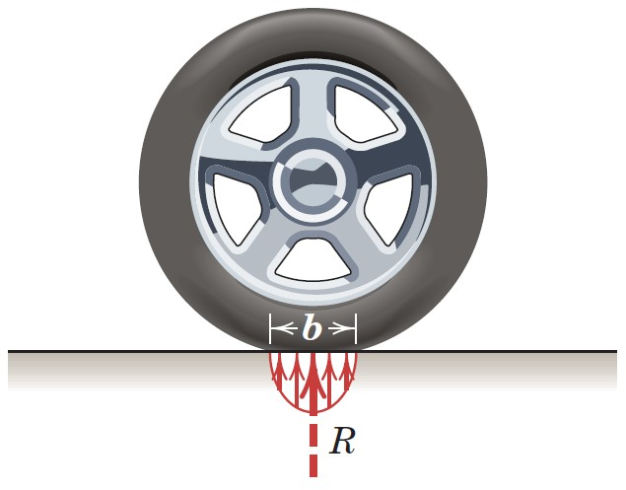
Article 5/1 Introduction
Concentrated Forces
Distributed Forces
Forces are spread out over a line, area, or volume.
Treated as concentrated forces when analyzing their external effects on a body.
Occur when a force is applied over a region whose dimensions are not negligible compared with other pertinent dimensions.

Slide 3
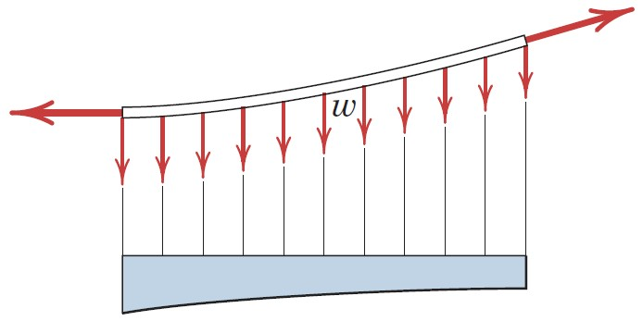
Article 5/1 – Categories of Distributed Forces (1 of 3)
Line Distribution
Illustration
Intensity w is N/m or lb/ft

Slide 4
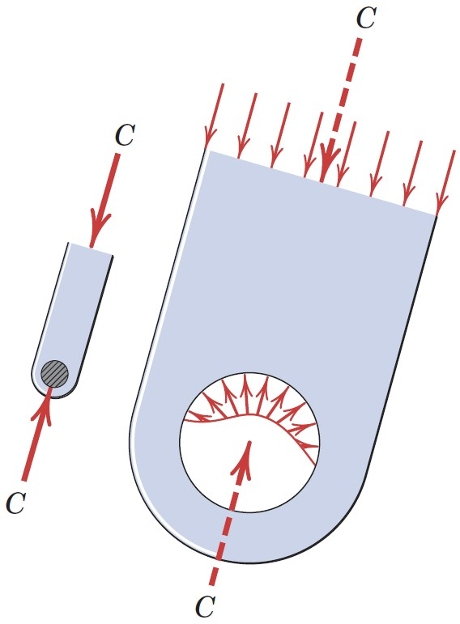
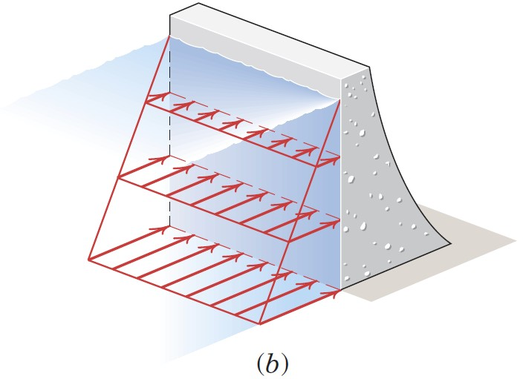
Article 5/1 – Categories of Distributed Forces (2 of 3)
Area Distribution
Illustrations
Intensity is termed pressure for fluids and stress for solids.
SI unit is the Pascal (Pa).
1 Pa = 1 N/m²
6895 Pa = 1 lb/in.²
Pressure is commonly reported in kilopascals (kPa = 10³ Pa).
Stress is commonly reported in megapascals (MPa = 10⁶ Pa).

Slide 5
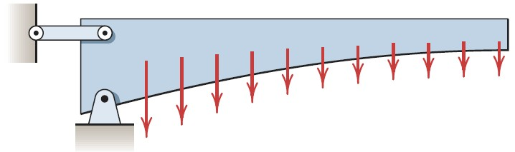
Article 5/1 – Categories of Distributed Forces (3 of 3)
Volume Distribution (Body Force)
Illustration
Most common body force is gravitational attraction.
Intensity is termed specific weight, γ = ρg.
ρ = density (mass per unit volume)
g = acceleration due to gravity
SI units are N/m³
U.S. customary units are lb/ft³ or lb/in.³

Slide 6
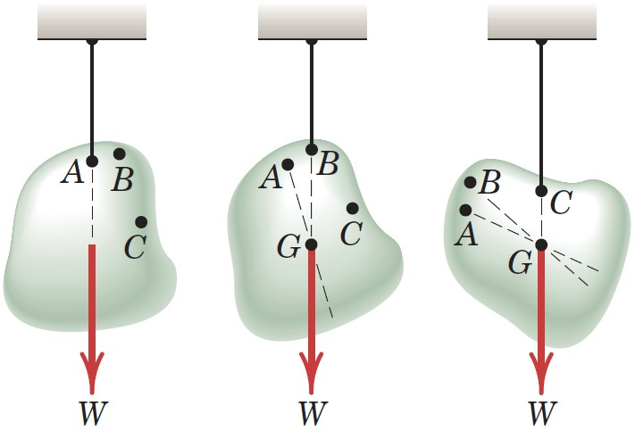
Article 5/2 Center of Mass
Introduction
Illustration with Hanging Mass
Center of Gravity, G
Assumptions

Slide 7
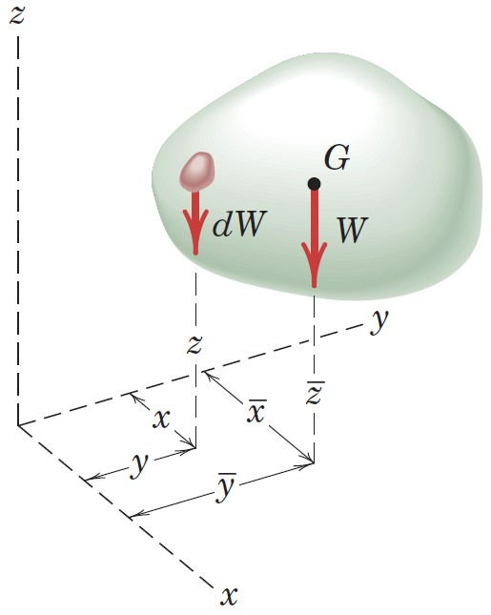
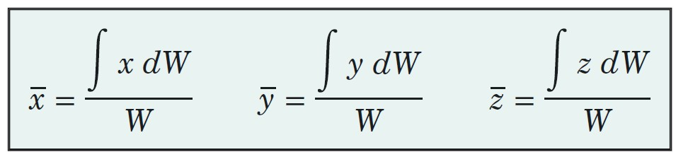
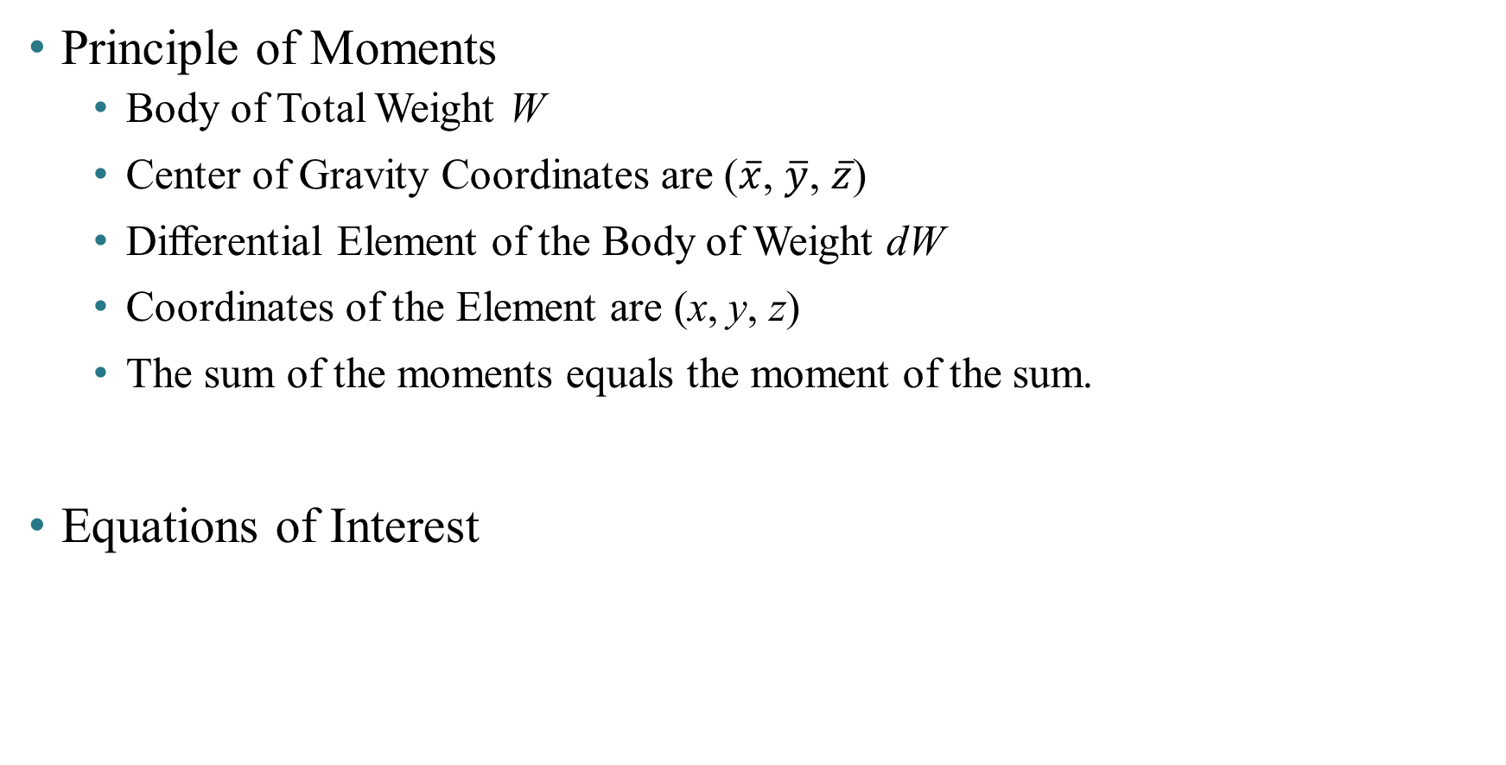
Article 5/2 – Determining the Center of Gravity (1 of 3)
Principle of Moments
Body of Total Weight W
Center of Gravity Coordinates are ($\overline{x}$, $\overline{y}$, $\overline{z}$)
Differential Element of the Body of Weight dW
Coordinates of the Element are (x, y, z)
The sum of the moments equals the moment of the sum.
Equations of Interest

Slide 8
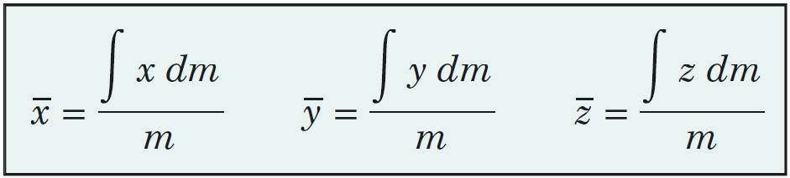
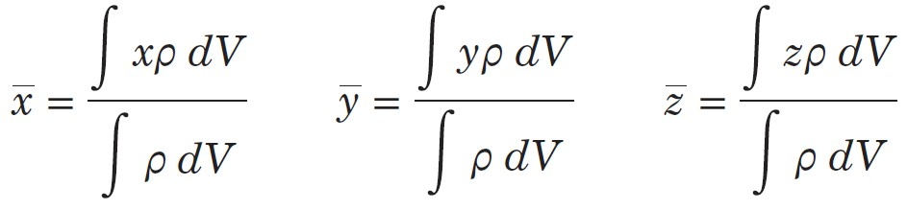
Article 5/2 – Determining the Center of Gravity (2 of 3)
Substitute W = mg and dW = g dm…
Substitute ρ = mV and dm = ρ dV, with ρ variable…

Slide 9
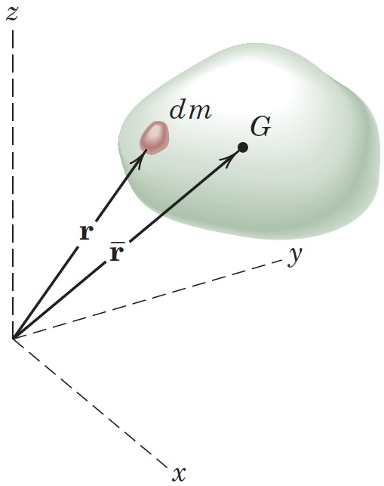
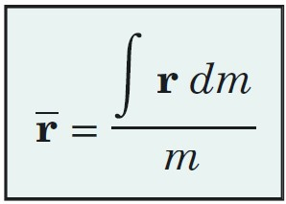
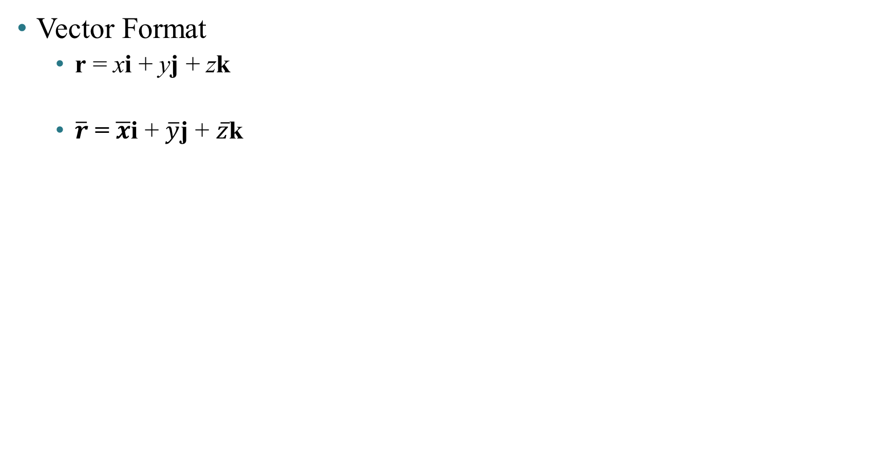
Article 5/2 – Determining the Center of Gravity (3 of 3)
Vector Format
r = xi + yj + zk
$\overline{r}$ = $\overline{x}$i + $\overline{y}$j + $\overline{z}$k

Slide 10
Article 5/2 – Center of Mass versus Center of Gravity
Center of Mass is…
a unique point in the body which is only a function of the distribution of mass.
coincident with the center of gravity if the gravitational field is uniform and parallel.
still present when the body is removed from a gravitational field.
the preferred choice of reference.
important in calculating the dynamic response of a body to unbalanced forces.

Slide 11
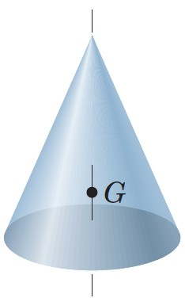
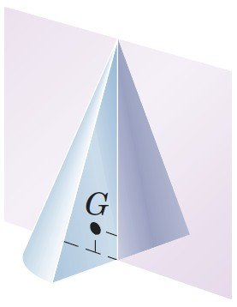
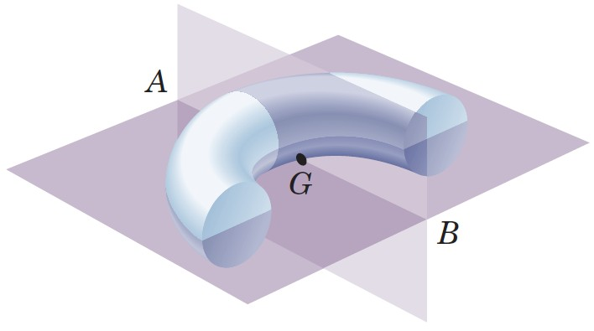
Article 5/2 – Comments about the Center of Mass
Tips and Hints
Choice of Axes
Lines and Planes of Symmetry

Slide 12
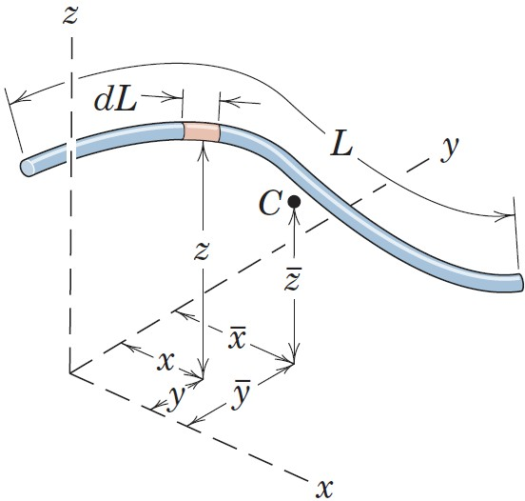
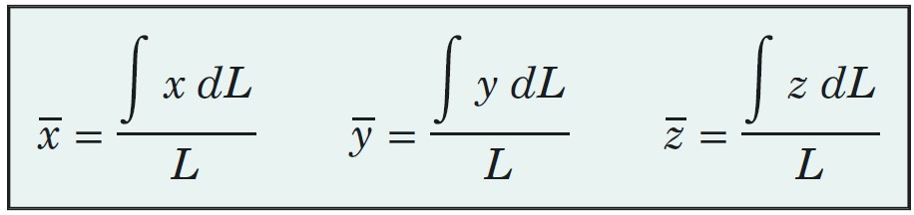
Article 5/3 Centroids of Lines, Areas, and Volumes
Centroid
Term used when a center of mass calculation concerns a geometric shape only.
Centroids of Lines
Differential segment dm = ρA dL
A = cross-sectional area of line
Equations of interest if ρ and A are constant…

Slide 13
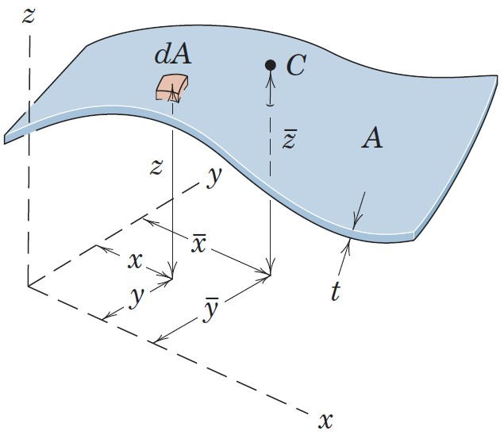
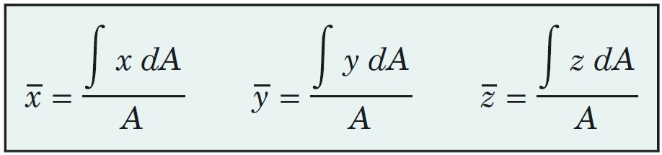
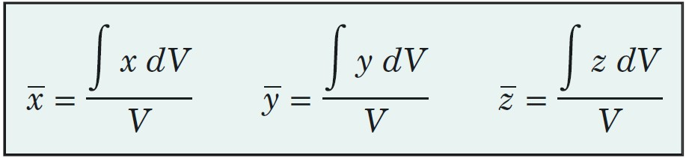
Article 5/3 – Centroids (cont.)
Centroids of Areas
Differential section dm = ρt dA
t = thickness of area
Equations of interest if ρ and t are constant…
Centroids of Volumes
Differential portion dm = ρ dV
Equations of interest if ρ is constant…

Slide 14
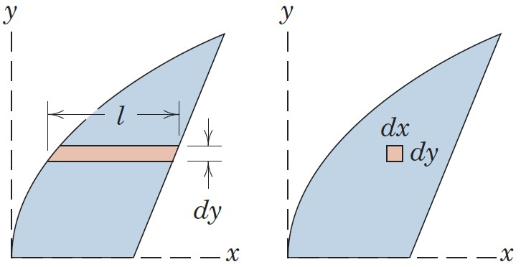
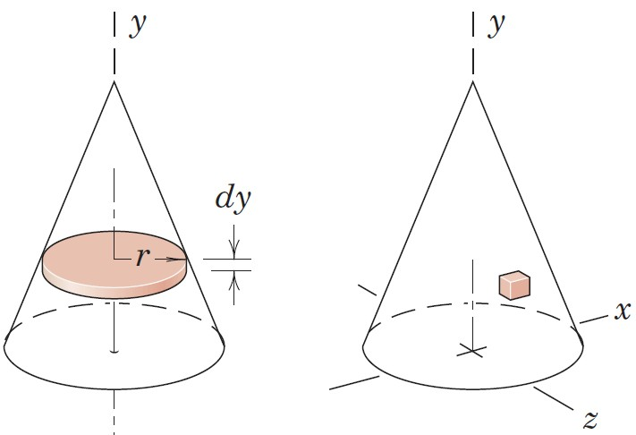
Article 5/3 – Choice of Element for Integration (1 of 6)
Order of Element
Whenever possible, select a first-order differential element to reduce the number of integrations.
Lower: Horizontal Strip, dA = l dy
Higher: Square, dA = dx dy
Lower: Circular Disk, dV = πr² dy
Higher: Cube, dV = dx dy dz

Slide 15
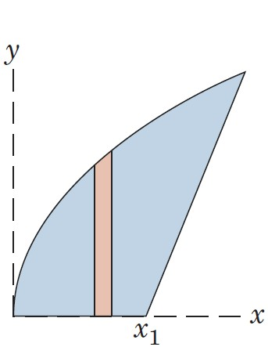
Article 5/3 – Choice of Element for Integration (2 of 6)
Continuity
Whenever possible, choose an element which can be integrated in one continuous operation to cover the figure.
Horizontal strip requires one integration in dy because the boundaries for the right and left ends of the strip are continuous in the vertical direction
Vertical strip requires two integrations in dx because the boundaries for the top and bottom of the strip are not continuous in the horizontal direction.

Slide 16
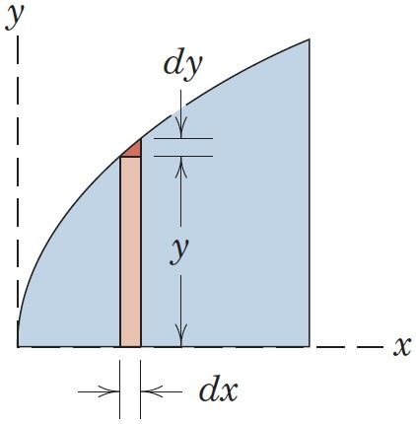
Article 5/3 – Choice of Element for Integration (3 of 6)
Discarding Higher-Order Terms
Higher order terms may always be dropped when compared to lower-order terms.
First Order: dA = y dx
Second Order: dA′ = ½ dy dx

Slide 17
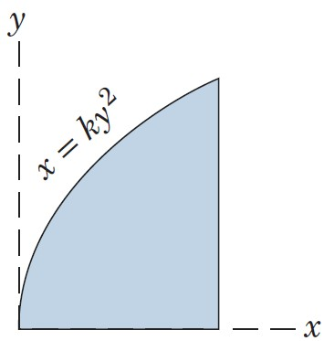
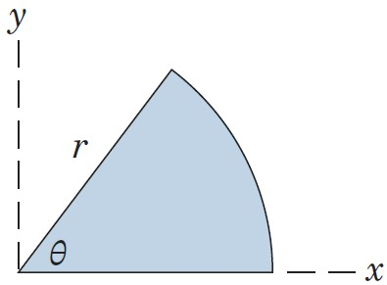
Article 5/3 – Choice of Element for Integration (4 of 6)
Choice of Coordinates
Choose the coordinate system which best matches the boundaries of the figure.
Rectangular Coordinates: x = ky²
Polar Coordinates

Slide 18
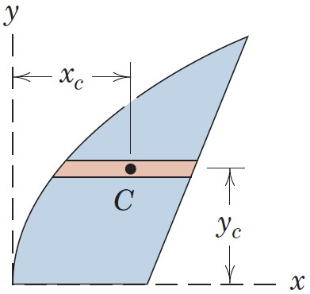
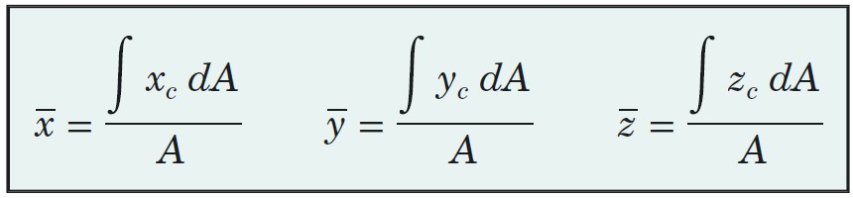
Article 5/3 – Choice of Element for Integration (5 of 6)
Centroidal Coordinate of Element
When a first- or second-order differential element is chosen, it is essential to use the coordinate of the centroid of the element for the moment arm in expressing the moment of the differential element.
Example with a Horizontal Strip
New Equations

Slide 19
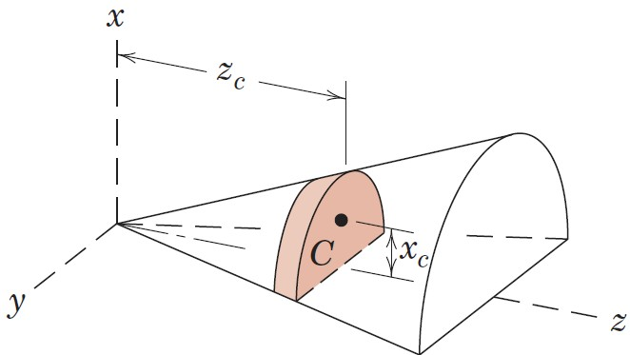
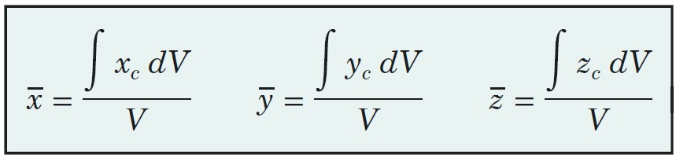
Article 5/3 – Choice of Element for Integration (6 of 6)
Centroidal Coordinate of Element (cont.)
Example with a Semicircular Slice
New Equations

Slide 20
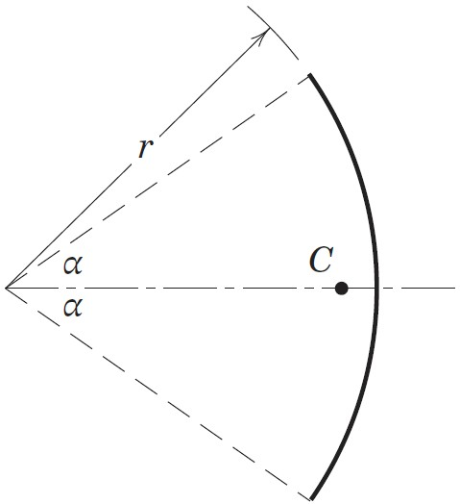
Article 5/3 – Sample Problem 5/1 (1 of 2)
Problem Statement
Locate the centroid of a circular arc as shown in the figure.

Slide 21
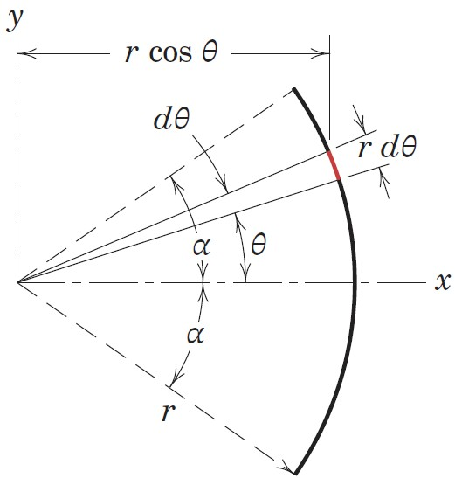
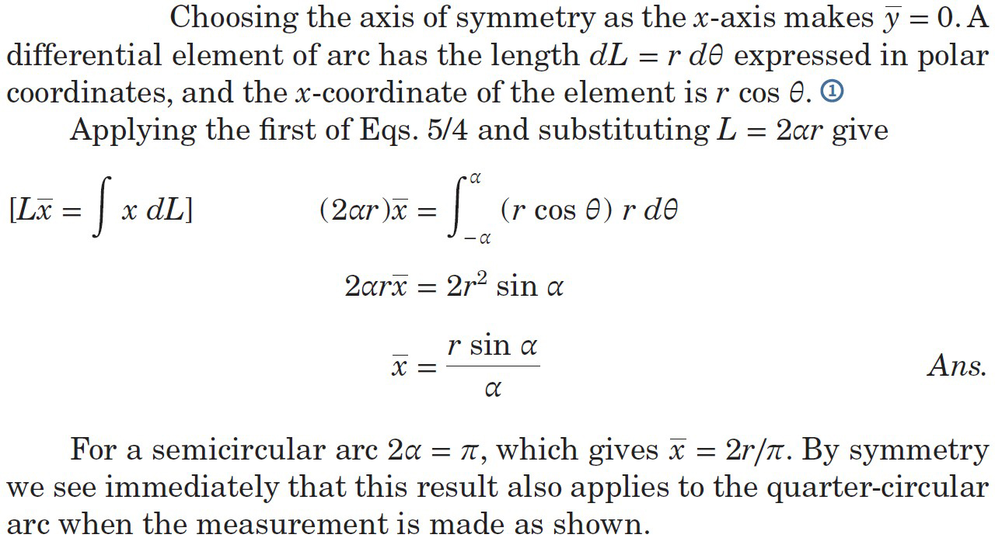
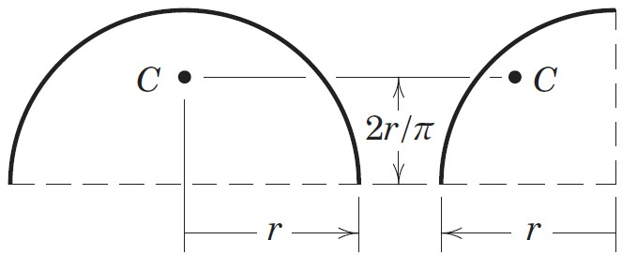
Article 5/3 – Sample Problem 5/1 (2 of 2)
Solution

Slide 22
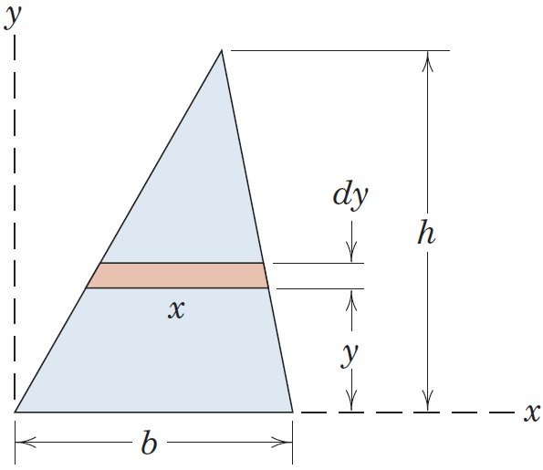
Article 5/3 – Sample Problem 5/2 (1 of 2)
Problem Statement
Determine the distance h from the base of a triangle of altitude h to the centroid of its area.

Slide 23
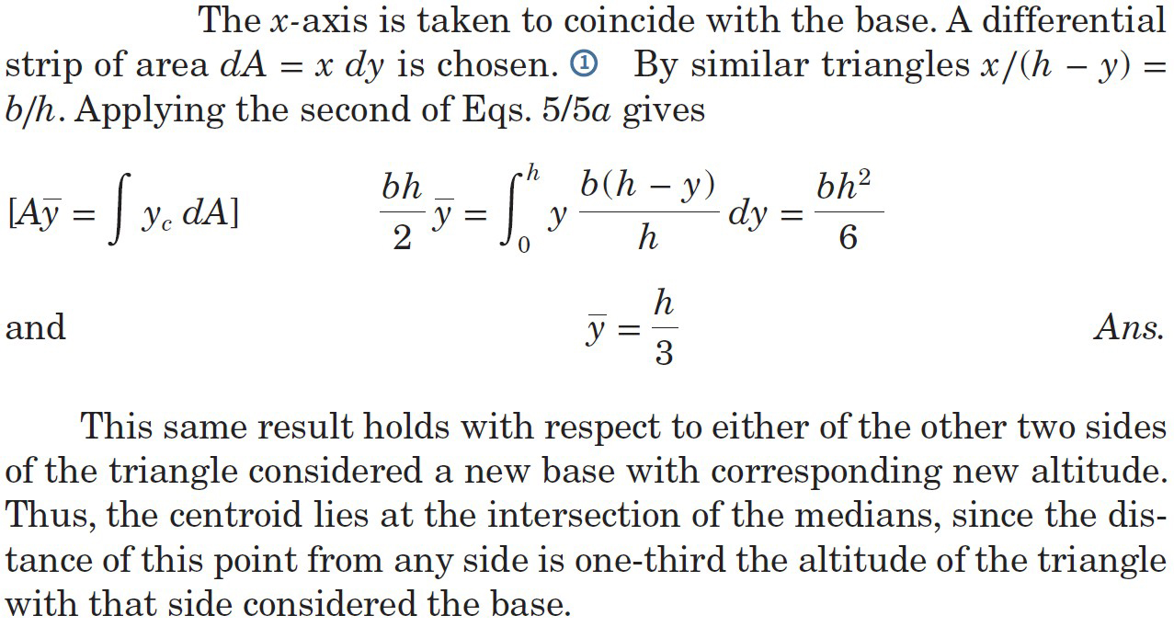
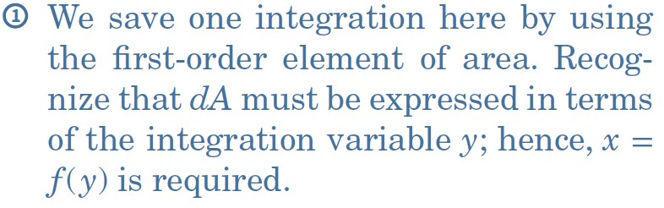
Article 5/3 – Sample Problem 5/2 (2 of 2)
Solution

Slide 24
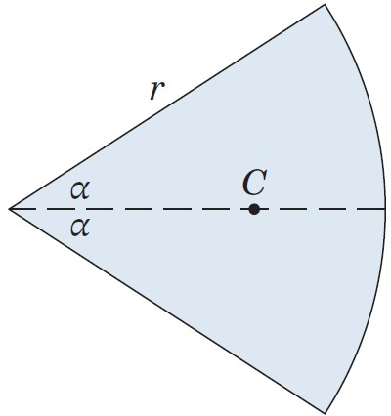
Article 5/3 – Sample Problem 5/3 (1 of 3)
Problem Statement
Locate the centroid of the area of a circular sector with respect to its vertex.

Slide 25
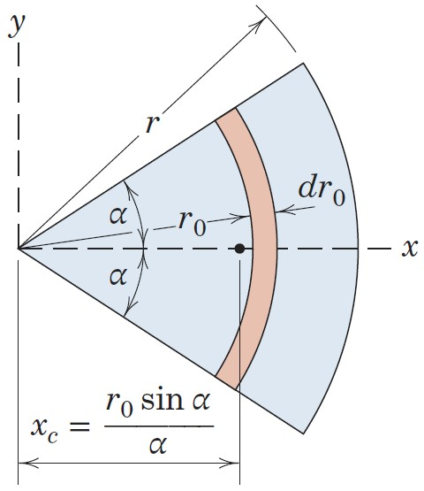
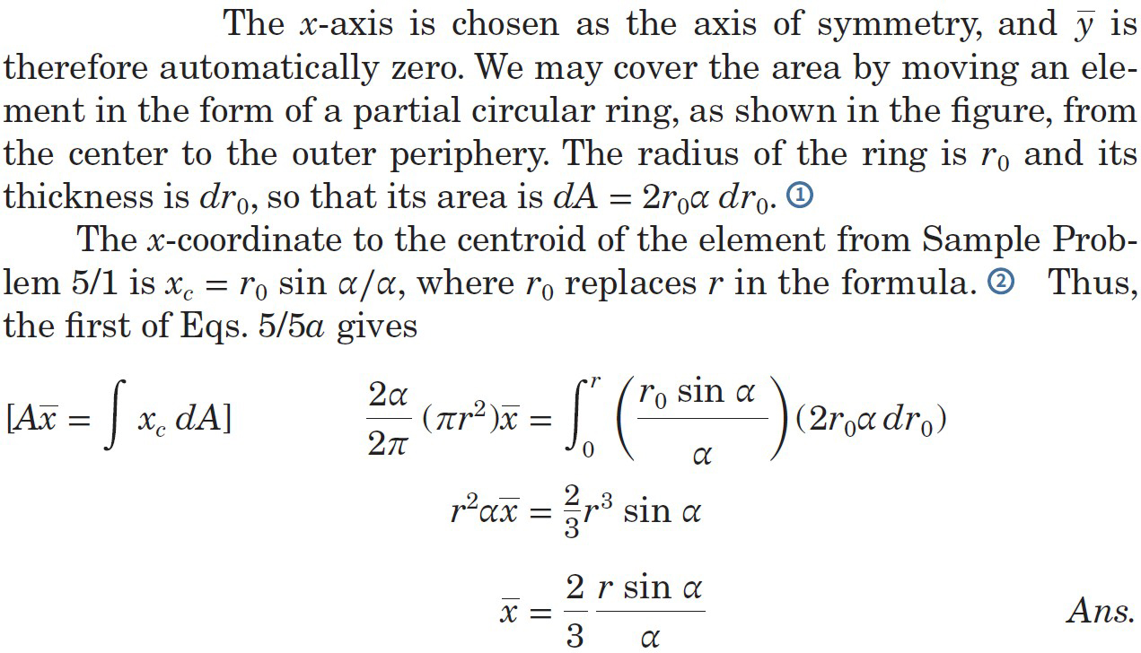
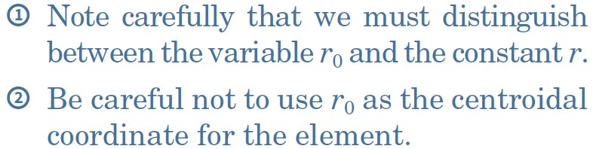
Article 5/3 – Sample Problem 5/3 (2 of 3)
Solution I

Slide 26
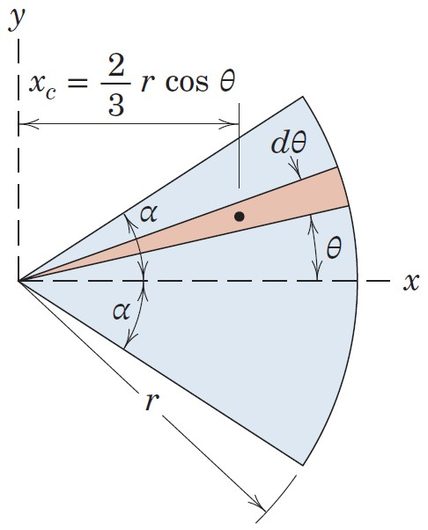
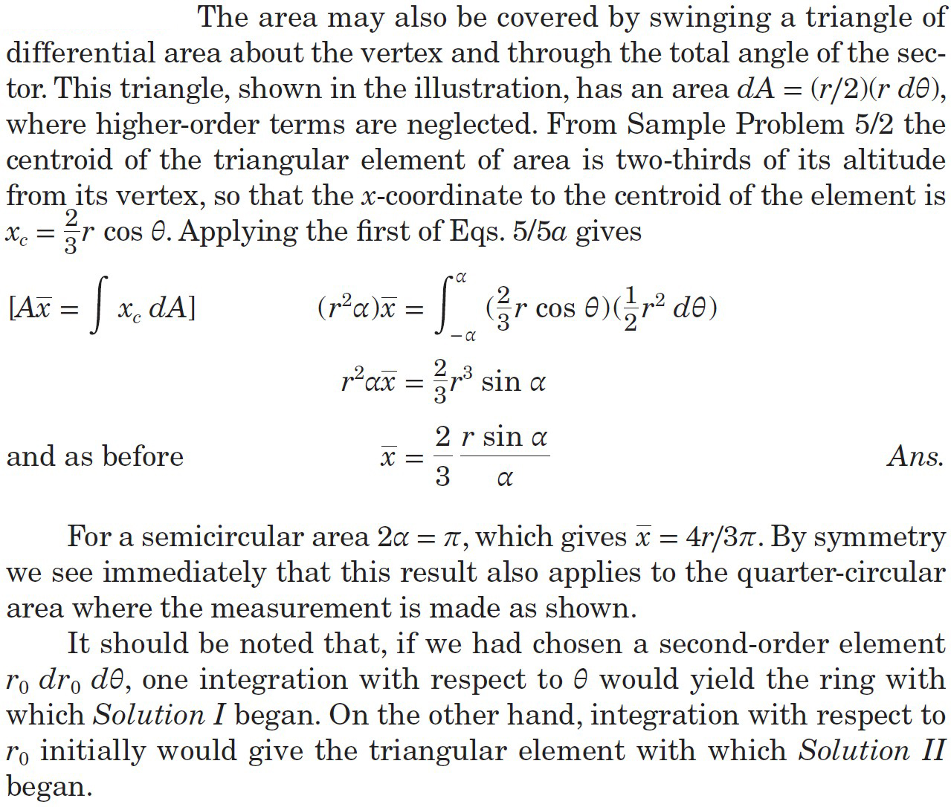
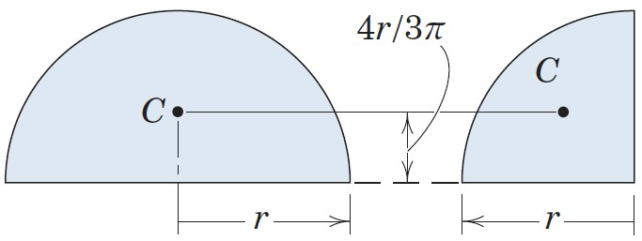
Article 5/3 – Sample Problem 5/3 (3 of 3)
Solution II

Slide 27
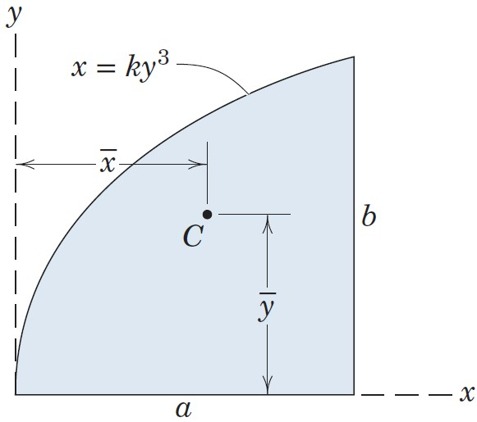
Article 5/3 – Sample Problem 5/4 (1 of 3)
Problem Statement
Locate the centroid of the area under the curve x = ky³ from x = 0 to x = a.

Slide 28
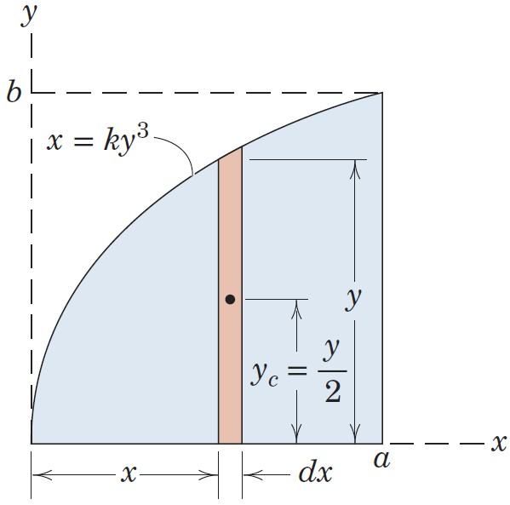
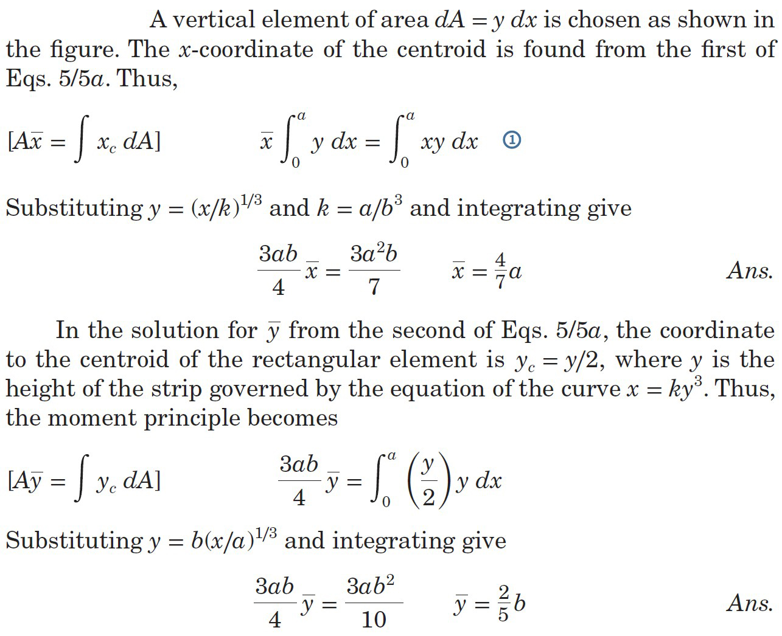
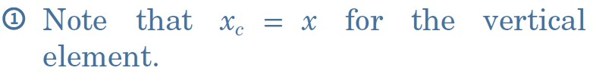
Article 5/3 – Sample Problem 5/4 (2 of 3)
Solution I: Vertical Strip

Slide 29


Article 5/3 – Sample Problem 5/4 (3 of 3)
Solution II: Horizontal Strip

Slide 30

Article 5/3 – Sample Problem 5/5 (1 of 4)
Problem Statement
Locate the centroid of the volume of a hemisphere of radius r with respect to its base.

Slide 31


Article 5/3 – Sample Problem 5/5 (2 of 4)
Solution I: Circular Slice

Slide 32


Article 5/3 – Sample Problem 5/5 (3 of 4)
Solution II: Cylindrical Shell

Slide 33


Article 5/3 – Sample Problem 5/5 (4 of 4)
Solution III: Use θ as the Variable

Slide 34


Article 5/4 Composite Bodies and Figures; Approximations
Overview of Composites
General Expressions
Analogous equations exist for lines, areas, and volumes by replacing the m’s with L’s, A’s, and V’s, respectively.

Slide 35


Article 5/4 – Comments about Composite Bodies
Identify composite pieces based on Table D/3 and D/4 in Appendix D.
Treat holes and cutouts as negative quantities. In the upper shape, the rectangular cutout has an area of -8 in.².
Measure the centroidal coordinate for every piece from the origin of your reference axes. In the upper shape, the horizontal centroidal coordinate of the rectangular cutout is 12 in., not 1 in.
Most objects consist of a single type of composite piece geometry (lines, areas, or volumes), but sometimes they are combined. For example, the upper shape consists of areas, while the lower shape consists of areas and volumes. To find the centroid of the lower shape, you must use the mass of the individual pieces.

Slide 36


Article 5/4 – An Approximation Method
When the boundaries of an area (or volume) are not expressible in terms of simple geometrical shapes or mathematical expressions…
Divide the body into individual pieces.
Calculate the area A = h Δx of each piece.
Determine the centroidal coordinates, x_{c} and y_{c} for each piece.
Evaluate the expression…

Slide 37


Article 5/4 – Irregular Volumes
The centroidal location of an irregular volume may be simplified to one of locating the centroid of an area.
Plot the magnitudes of the cross-sectional areas A.
Calculate the volume V = A Δx of individual slices.
Determine the centroidal coordinates x_{c} of each slice.
Evaluate the expression…

Slide 38


Article 5/4 – Centroids of Common Shapes (1 of 6)

Slide 39


Article 5/4 – Centroids of Common Shapes (2 of 6)

Slide 40


Article 5/4 – Centroids of Common Shapes (3 of 6)

Slide 41


Article 5/4 – Centroids of Common Shapes (4 of 6)

Slide 42


Article 5/4 – Centroids of Common Shapes (5 of 6)

Slide 43



Article 5/4 – Centroids of Common Shapes (6 of 6)

Slide 44
Article 5/4 – Sample Problem 5/6 (1 of 3)
Problem Statement
Locate the centroid of the shaded area.

Slide 45

Article 5/4 – Sample Problem 5/6 (2 of 3)
Composite Shapes
Rectangular Area (1)
Triangular Area (2)
Semicircular Cutout (3)
Square Cutout (4)

Slide 46

Article 5/4 – Sample Problem 5/6 (2 of 3)
Tabulated Values

Slide 47

Article 5/4 – Sample Problem 5/7 (1 of 2)
Problem Statement
Approximate the x-coordinate of the volume centroid of a body whose length is 1 m and whose cross-sectional area varies with x as shown in the figure.

Slide 48


Article 5/4 – Sample Problem 5/7 (2 of 2)
Solution

Slide 49
Article 5/4 – Sample Problem 5/8 (1 of 4)
Problem Statement
Locate the center of mass of the bracket-and-shaft combination. The vertical face is made from sheet metal which has a mass of 25 kg/m². The material of the horizontal base has a mass of 40 kg/m², and the steel shaft has a density of 7.83 Mg/m³.

Slide 50

Article 5/4 – Sample Problem 5/8 (2 of 4)
Composite Shapes
Semicircular Area (1)
Square Plate (2)
Triangular Cutout (3)
Rectangular Flat (4)
Cylindrical Shaft (5)

Slide 51

Article 5/4 – Sample Problem 5/8 (3 of 4)
Solution Comments

Slide 52

Article 5/4 – Sample Problem 5/8 (4 of 4)
Tabulated Values

Slide 53


Article 5/5 Theorems of Pappus
Area of a Revolved Line Segment
L = length of a revolved line segment
$\overline{y}$ = y-coordinate of the centroid C for the line of length L
Equation of Interest: A = 2π$\overline{y}$L
For a partial revolution through the angle θ…
A = θ$\overline{y}$L where θ is expressed in radians

Slide 54


Article 5/5 – Theorems of Pappus (cont.)
Volume of a Solid of Revolution
A = area of a revolved section
$\overline{y}$ = y-coordinate of the centroid C for the area A
Equation of Interest: V = 2π$\overline{y}$A
For a partial revolution through the angle θ…
V = θ$\overline{y}$A where θ is expressed in radians

Slide 55

Article 5/5 – Sample Problem 5/9 (1 of 2)
Problem Statement
Determine the volume V and surface area A of the complete torus of circular cross section.

Slide 56


Article 5/5 – Sample Problem 5/9 (2 of 2)
Solution

Slide 57

Article 5/5 – Sample Problem 5/10 (1 of 2)
Problem Statement
Calculate the volume V of the solid generated by revolving the 60-mm right-triangular area through 180° about the z-axis. If this body were constructed of steel, what would be its mass m?

Slide 58


Article 5/5 – Sample Problem 5/10 (2 of 2)
Solution

Slide 59


Article 5/6 Beams – External Effects
Introduction
Types of Beams
Determinate
Indeterminate
Types of Supports

Slide 60

Article 5/6 – Distributed Loads
Illustration
Intensity of a Distributed Load, w
Units are Force/Length (N/m or lb/ft)
Various Types, e.g., Constant, Linear, Functional
Question: How do we analyze the external reactions on a beam subjected to various distributed loads?
Answer: We must replace the distributed load by its equivalent concentrated force which acts at the appropriate location.

Slide 61


Article 5/6 – Types of Distributed Loads (1 of 2)
Uniform Loads
Linear Loads

Slide 62




Article 5/6 – Types of Distributed Loads (2 of 2)
Trapezoidal Loads
Functional Loads

Slide 63

Article 5/6 – Sample Problem 5/11 (1 of 2)
Problem Statement
Determine the equivalent concentrated load(s) and external reactions for the simply supported beam which is subjected to the distributed load shown.

Slide 64




Article 5/6 – Sample Problem 5/11 (2 of 2)
Solution

Slide 65

Article 5/6 – Sample Problem 5/12 (1 of 2)
Problem Statement
Determine the reaction at the support A of the loaded cantilever beam.

Slide 66



Article 5/6 – Sample Problem 5/12 (2 of 2)
Solution

Slide 67

Article 5/7 Beams – Internal Effects
Internal Loads in Beams
Shear Force
Bending Moment
Torsional Moment

Slide 68
Article 5/7 – Internal Loads (cont.)
Combined Loading Effect

Slide 69


Article 5/7 – Shear and Bending Explored
Sign Convention for V and M
Visualization of the Bending Moment

Slide 70


Article 5/7 – Shear-Force and Bending-Moment Diagrams
Overview
Solution Steps
Determine the external reactions which act on the beam.
Isolate a portion of the beam, either to the right or the left of an arbitrary transverse section, and construct a free-body diagram of the section. Sections cannot be taken at a discontinuity in the loading diagram, e.g., at a reaction or concentrated force, or at a discontinuity in a distributed load. Loads in the section should be shown in a positive sign convention.
Apply the equations of equilibrium to the isolated portion to determine expressions for the shear force V and the bending moment M which act in that portion of the beam.
Plot the resulting expressions over the section of the beam for which they are valid.
Continue to the next section until the entire beam has been analyzed.

Slide 71


Article 5/7 – General Loading, Shear, and Moment Relationships
Situation of Interest
Free-Body Diagram of a Segment
Solution Process
Vertical Equilibrium yields V
Moment Equilibrium yields M

Slide 72
Article 5/7 – Relationships between Shear and Loading (1 of 3)
Vertical Equilibrium (positive up)
Result 1: Indefinite integral of both sides.
The expression for the internal shear force in a region of the beam as a function of x is found by integrating the equation for the distributed loading within that region of the beam and adding an appropriate constant. The integral expression must be multiplied by a negative to obtain the correct relationship.
The constant C₁ is most often determined as the value of the shear force at the beginning of the section of the beam where the distributed loading is defined.

Slide 73
Article 5/7 – Relationships between Shear and Loading (2 of 3)
Vertical Equilibrium
Result 2: Definite integral of both sides.
The change in the value of the internal shear force between two points on a beam is the negative of the area under the distributed loading curve between those same two points.
Note that V₁ is the value of the shear force at the coordinate x₁, and V₂ is the value of the shear force at the coordinate x₂.

Slide 74
Article 5/7 – Relationships between Shear and Loading (3 of 3)
Vertical Equilibrium
Result 3: Divide both sides by dx.
The slope of the internal shear-force diagram at any location on a beam is equal to the negative intensity of the distributed loading at that point.
If there is no distributed loading at a location in the beam, then the slope is zero at that location meaning the shear force is temporarily constant.

Slide 75
Article 5/7 – Relationships between Moment and Loading (1 of 3)
Moment Equilibrium (about Left Side, CCW +)
Result 4: Indefinite integral of both sides.
The expression for the internal bending moment in a region of the beam is found by integrating the equation for the internal shear force within that region of the beam and adding an appropriate constant.
The constant C₂ is most often determined as the value of the bending moment at the beginning of the section of the beam where the distributed loading is defined.
Note that the expression for V was determined from the first integral of the loading function, so the bending moment is the second integral of the loading function.

Slide 76
Article 5/7 – Relationships between Moment and Loading (2 of 3)
Moment Equilibrium (about Left Side, CCW +)
Result 5: Definite integral of both sides.
The change in the value of the internal bending moment between two points on a beam is the area under the shear force diagram between those same two points.
Note that M₁ is the value of the bending moment at the coordinate x₁, and M₂ is the value of the bending moment at the coordinate x₂.

Slide 77
Article 5/7 – Relationships between Moment and Loading (3 of 3)
Moment Equilibrium (about Left Side, CCW +)
Result 6: Divide both sides by dx.
The slope of the internal bending moment diagram at any location on a beam is equal to the value of the internal shear force at that point.
If there is no shear force at a location in the beam, then the slope is zero at that location meaning the bending moment is temporarily constant.
When V passes through zero and is continuous function of x with dV/dx ≠ 0, the bending moment M will be a maximum or a minimum. Critical values of M also occur when V crosses the zero axis discontinuously which occurs at a concentrated load.

Slide 78

Article 5/7 – Effect of a Concentrated Force (1 of 2)
Situation of Interest
Vertical Equilibrium (positive up)
Result 7
An externally applied, concentrated force creates a change in the internal shear force that is consistent with both the magnitude and direction of the concentrated force.
A downward force creates an instantaneous drop in the internal shear force and an upward force creates an instantaneous rise in the internal shear force. The drop or rise is equal to the magnitude of the concentrated force.

Slide 79
Article 5/7 – Effect of a Concentrated Force (2 of 2)
Moment Equilibrium (at B, CCW+, dx→0)
Result 8
An externally applied, concentrated force has no effect on the value of the internal bending moment at the point of application.
An externally applied, concentrated force will create a sudden change in the slope of the bending-moment diagram at the point of application.

Slide 80

Article 5/7 – Effect of a Concentrated Moment (1 of 2)
Situation of Interest
Vertical Equilibrium (positive up)
Result 9
An externally applied, concentrated moment has no effect on the value of the internal shear force at the point of application for the moment.

Slide 81
Article 5/7 – Effect of a Concentrated Moment (2 of 2)
Moment Equilibrium (at B, CCW+, dx→0)
Result 10
An externally applied, concentrated moment creates a change in the internal bending moment that is consistent with the magnitude of the concentrated moment, but is inconsistent with the direction of the concentrated moment.
An externally applied counterclockwise moment creates an instantaneous drop in the internal bending moment and an externally applied clockwise moment creates an instantaneous rise in the internal bending moment. The drop or rise is equal to the magnitude of the concentrated moment.

Slide 82

Article 5/7 – Sample Problem 5/13 (1 of 4)
Problem Statement
Determine the shear and moment distributions produced in the simple beam by the 4-kN concentrated load.

Slide 83


Article 5/7 – Sample Problem 5/13 (2 of 4)
Support Reactions

Slide 84



Article 5/7 – Sample Problem 5/13 (3 of 4)
Beam Segment Equilibrium

Slide 85


Article 5/7 – Sample Problem 5/13 (4 of 4)
V and M Diagrams

Slide 86

Article 5/7 – Sample Problem 5/14 (1 of 5)
Problem Statement
The cantilever beam is subjected to the load intensity (force per unit length) which varies as w = w₀ sin (𝜋x/l). Determine the shear force V and bending moment M as functions of the ratio x/l.

Slide 87



Article 5/7 – Sample Problem 5/14 (2 of 5)
Support Reactions

Slide 88



Article 5/7 – Sample Problem 5/14 (3 of 5)
Shear-Force Expression

Slide 89

Article 5/7 – Sample Problem 5/14 (4 of 5)
Bending-Moment Expression

Slide 90


Article 5/7 – Sample Problem 5/14 (5 of 5)
V and M Diagrams

Slide 91
Article 5/7 – Sample Problem 5/15 (1 of 6)
Problem Statement
Draw the shear-force and bending-moment diagrams for the loaded beam and determine the maximum moment M and its location x from the left end.

Slide 92

Article 5/7 – Sample Problem 5/15 (2 of 6)
Support Reactions
The support reactions are most easily obtained by considering the resultants of the distributed loads as shown on the free-body diagram of the beam as a whole.

Slide 93


Article 5/7 – Sample Problem 5/15 (3 of 6)
First Beam Segment: 0 < x < 4 ft

Slide 94


Article 5/7 – Sample Problem 5/15 (4 of 6)
Second Beam Segment: 4 < x < 8 ft

Slide 95


Article 5/7 – Sample Problem 5/15 (5 of 6)
Third Beam Segment: 8 < x < 10 ft
V + 653 - 300 = 0 V = -353 lb
-M + 653(12 - x - 2) - 300(12 - x) = 0 M = 2930 - 353x
Fourth Beam Segment: 10 < x < 12 ft

Slide 96

Article 5/7 – Sample Problem 5/15 (6 of 6)
V and M Diagrams

Slide 97


Article 5/8 Flexible Cables
Introduction
Examples
Parameters of Importance
Tension
Span
Sag
Length
Load Intensity

Slide 98


Article 5/8 – General Relationships (1 of 3)
Variable and Continuous Load, w
Resultant, R = ∫w dx
Location, R$\overline{x}$ = ∫xw dx

Slide 99

Article 5/8 – General Relationships (2 of 3)
Equilibrium of a Cable Segment
Trigonometric and Small-Angle Substitutions
Result
$$\sin{dθ≅dθ}$$
$$\cos{dθ≅1}$$

Slide 100

Article 5/8 – General Relationships (3 of 3)
Rewrite Equations
Result
Horizontal component of the cable tension remains unchanged, so we introduce the variable T₀ = T cos θ to represent it.
Substitute T = T₀/cos θ into the first equation to obtain the differential equation for the flexible cable.
Note: tan θ = dy/dx

Slide 101


Article 5/8 – Parabolic Cables (1 of 3)
Characteristics
Cable Weight is Negligible
Vertical Loading, w, is Constant
Span, l
Sag, h
Length, s
Shape is a Parabolic Arch
Coordinate Origin at Lowest Point
Free-Body Diagram of a Cable Segment

Slide 102

Article 5/8 – Parabolic Cables (2 of 3)
Integrate General Relationship Twice…
Equations of Interest

Slide 103


Article 5/8 – Parabolic Cables (3 of 3)
Suspension Bridge
Total Span, L = 2l_{A}
Sag, h = h_{A}
Total Length, S = 2s_{A}
Equations of Interest

Slide 104

Article 5/8 – Catenary Cables (1 of 3)
Characteristics
Cable Hangs Under Action of its Weight Only
Cable Weight per Unit Length, μ
Span, l
Sag, h
Length, s
Shape is a Catenary
Coordinate Origin at Lowest Point

Slide 105


Article 5/8 – Catenary Cables (2 of 3)
Free-Body Diagram of a Cable Segment
Resultant, R = μs
From Before, w dx = μ ds
Substitute into the General Expression…

Slide 106
Article 5/8 – Catenary Cables (3 of 3)
Equations of Interest
Note: Catenary cable problems generally require numerical solutions!

Slide 107

Article 5/8 – Sample Problem 5/16 (1 of 2)
Problem Statement
A 100-ft length of surveyor’s tape weighs 0.6 lb. When the tape is stretched between two points on the same level by a tension of 10 lb at each end, calculate the sag h in the middle.

Slide 108


Article 5/8 – Sample Problem 5/16 (2 of 2)
Solution

Slide 109

Article 5/8 – Sample Problem 5/17 (1 of 3)
Problem Statement
The light cable supports a mass of 12 kg per meter of horizontal length and is suspended between the two points on the same level 300 m apart. If the sag is 60 m, find the tension at midlength, the maximum tension, and the total length of the cable.

Slide 110




Article 5/8 – Sample Problem 5/17 (2 of 3)
Midlength Tension
Maximum Tension

Slide 111

Article 5/8 – Sample Problem 5/17 (3 of 3)
Cable Length

Slide 112

Article 5/8 – Sample Problem 5/18 (1 of 3)
Problem Statement
Replace the cable of Sample Problem 5/17, which is loaded uniformly along the horizontal, by a cable which has a mass of 12 kg per meter of its own length and supports its own weight only. The cable is suspended between two points on the same level 300 m apart and has a sag of 60 m. Find the tension at midlength, the maximum tension, and the total length of the cable.

Slide 113


Article 5/8 – Sample Problem 5/18 (2 of 3)
Midlength Tension

Slide 114


Article 5/8 – Sample Problem 5/18 (3 of 3)
Maximum Tension
Cable Length

Slide 115
Article 5/9 Fluid Statics
Introduction
Important Concepts
A fluid is any continuous substance which, when at rest, is unable to support a shear force. Fluids are either gaseous or liquid.
A shear force is any force which is tangent to the surface on which it acts.
Fluids at rest can only exert normal forces on a bounding surface.
The statics of fluids is called hydrostatics when the fluid is a liquid and aerostatics when the fluid is a gas.

Slide 116

Article 5/9 – Fluid Pressure at a Point (1 of 3)
Pascal’s Law
The pressure at any given point in a fluid is the same in all directions.
Equilibrium of a Fluid Prism
Since ds sin θ = dy and ds cos θ = dx…
Rotating the element 90° would show the same thing for p₄.

Slide 117

Article 5/9 – Fluid Pressure at a Point (2 of 3)
Effect of Depth on Pressure in a Fluid at Rest
Vertical Equilibrium of a Fluid Slug, +h is Down
Generalized Result: p = p₀ + ρgh
p = the pressure at some depth h in a fluid
p₀ = the pressure on the surface of the fluid
ρ = the density of the fluid, constant if the fluid is incompressible
g = the acceleration of gravity, constant if the fluid depth is small
h = the depth below the surface of the fluid

Slide 118
Article 5/9 – Atmospheric, Absolute, and Gage Pressure
Atmospheric Pressure
Represented by the weight of a column of air which extends from the surface of the earth to the top of the atmosphere.
Standard value is 14.7 lb/in.² or 101.3 kPa.
In many problems, p₀ is atmospheric pressure.
Gage Pressure
Is a measurement of pressure which is made relative to atmospheric pressure.
Gage pressure in fluid statics is computed as ρgh.
Absolute Pressure
Is the sum of atmospheric and gage pressure.
In fluid statics, absolute pressure is computed as p₀ + ρgh.

Slide 119
Article 5/9 – Units of Pressure
Pressure is a force divided by an area.
SI Units
The most common unit is the Pascal (Pa), which is a newton per square meter.
Pa = N/m²
kilopascal (kPa) = 10³ Pa
U.S. Units
The most common unit is a pound per square inch (psi or lb/in.²) or a pound per square foot (psf or lb/ft²).
Conversion: 1 lb/in.² = 6895 Pa

Slide 120

Article 5/9 – Hydrostatic Pressure on Submerged Rectangular Surfaces (1 of 4)
Pressure
Varies linearly with depth according to ρgh, where the pressure at the liquid surface is atmospheric.
The pressure forms a trapezoidal prism which acts over the surface of the submerged plate.
Resultant R
Equal to the volume of the pressure prism.
Acts at the center of pressure P, which is the centroid of the pressure prism, not the centroid of the plate.

Slide 121


Article 5/9 – Hydrostatic Pressure on Submerged Rectangular Surfaces (2 of 4)
Calculation of R – Method 1
R = bA′
b = plate width normal to the plane of the figure.
A′ = geometrical area defined by the trapezoidal distribution of pressure, 1-2-6-5.
Acts at the center of pressure P.
Calculation of R – Method 2
R = p_{av}A = ρg$\overline{h}$A
p_{av} = average pressure acting on the plate, ½ (p₁ + p₂), or the pressure which exists at the average depth, measured to the centroid O of the plate.
A = area of the plate.
$\overline{h}$ = $\overline{y}$ cos θ, is the average depth of the plate, which is measured to the plate centroid O.
Acts at the center of pressure P.

Slide 122

Article 5/9 – Hydrostatic Pressure on Submerged Rectangular Surfaces (3 of 4)
Center of Pressure Location
The center of pressure P is located at the centroid of the trapezoidal pressure prism, which is easily found using composite techniques or evaluating the integral…

Slide 123

Article 5/9 – Hydrostatic Pressure on Submerged Rectangular Surfaces (4 of 4)
Calculation of R – Method 3
R₁ = ½ (p₁ - p₂)A
Acts at the centroid of the triangular portion of the pressure prism.
A = bL is the area of the plate
R₂ = p₂A
Acts at the centroid of the rectangular portion of the pressure prism.

Slide 124


Article 5/9 – Hydrostatic Pressure on Submerged Cylindrical Surfaces (1 of 2)
Illustration
Two-Dimensional Representation
Calculation Procedure – Method 1
Moment Equation will give Location

Slide 125

Article 5/9 – Hydrostatic Pressure on Submerged Cylindrical Surfaces (2 of 2)
Calculation Procedure – Method 2
P_{x} = pressure along CB and can be found using the techniques established for flat rectangular plates.
P_{y} = pressure along AC and can be found using the techniques established for flat rectangular plates.
W = weight of the fluid block and is the area ABC times the plate width b. The weight passes through the centroid of area ABC.

Slide 126



Article 5/9 – Hydrostatic Pressure on Submerged Irregular Flat Surfaces (1 of 2)
Illustration
Resultant
R = ∫ ρghx dy
R = ρg$\overline{h}$A
A = area of the plate.
$\overline{h}$ = $\overline{y}$ cos θ, is the average depth of the plate, which is measured to the plate centroid O.
Location
Acts at the center of pressure P which is the centroid of the irregular pressure volume.

Slide 127

Article 5/9 – Hydrostatic Pressure on Submerged Irregular Flat Surfaces (2 of 2)
Center of Pressure
The center of pressure P is located at the centroid of the trapezoidal pressure prism, which is easily found using composite techniques or evaluating the integral…
Note that the pressure p = ρgh = ρgy cos θ.
Also note that the center of pressure P and the centroid of the plate O are not the same.

Slide 128

Article 5/9 – Buoyancy (1 of 4)
Illustration
Description
Fluid Portion (a)
Replaced Fluid Portion Force Distribution (b)
Free-Body Diagram of Fluid Portion (c)
Equilibrium Requirements

Slide 129
Article 5/9 – Buoyancy (2 of 4)
Buoyant Force, F = ρgV
ρ = density of the fluid
g = acceleration of gravity
V = volume of the displaced fluid
The buoyant force is equal, opposite, and collinear with the weight of the fluid portion.
For objects at rest in a fluid, the buoyant force will be equal in magnitude to the weight of the fluid displaced by the object.

Slide 130

Article 5/9 – Buoyancy (3 of 4)
Stability of a Floating Object
B = center of buoyancy, which is the centroid of displaced fluid volume.
The buoyant force F will pass through the center of buoyancy, and is equal and opposite to the weight of the ship, as shown in Figure (a).
If the ship lists through an angle α, the shape of the displaced volume will change, and the center of buoyancy will shift to B′.

Slide 131
Article 5/9 – Buoyancy (4 of 4)
Stability of a Floating Object (cont.)
Metacenter M is the intersection of a vertical line through the center of buoyancy and the ship centerline.
Metacentric height h is the distance of the metacenter from the mass center of the ship. For most hull shapes h is roughly constant for lists up to 20°.
If M is above G, the buoyant force creates a restoring moment against listing.
If M is below G, the buoyant force will cause the list to increase.

Slide 132

Article 5/9 – Sample Problem 5/19 (1 of 2)
Problem Statement
A rectangular plate, shown in vertical section AB, is 4 m high and 6 m wide (normal to the plane of the paper) and blocks the end of a fresh-water channel 3 m deep. The plate is hinged about a horizontal axis along its upper edge through A and is restrained from opening by the fixed ridge B which bears horizontally against the lower edge of the plate. Find the force B exerted on the plate by the ridge.

Slide 133



Article 5/9 – Sample Problem 5/19 (2 of 2)
Solution

Slide 134

Article 5/9 – Sample Problem 5/20 (1 of 2)
Problem Statement
The air space in the closed fresh-water tank is maintained at a pressure of 0.80 lb/in.² (above atmospheric). Determine the resultant force R exerted by the air and water on the end of the tank.

Slide 135



Article 5/9 – Sample Problem 5/20 (2 of 2)
Solution

Slide 136

Article 5/9 – Sample Problem 5/21 (1 of 3)
Problem Statement
Determine completely the resultant force R exerted on the cylindrical dam surface by the water. The density of fresh water is 1.000 Mg/m³, and the dam has a length b, normal to the paper, of 30 m.

Slide 137



Article 5/9 – Sample Problem 5/21 (2 of 3)
Solution I

Slide 138



Article 5/9 – Sample Problem 5/21 (3 of 3)
Alternative Solution

Slide 139

Article 5/9 – Sample Problem 5/22 (1 of 3)
Problem Statement
Determine the resultant force R exerted on the semicircular end of the water tank shown in the figure if the tank is filled to capacity. Express the result in terms of the radius r and the water density 𝜌.

Slide 140


Article 5/9 – Sample Problem 5/22 (2 of 3)
Solution I

Slide 141


Article 5/9 – Sample Problem 5/22 (3 of 3)
Solution II

Slide 142

Article 5/9 – Sample Problem 5/23 (1 of 2)
Problem Statement
A buoy in the form of a uniform 8-m pole 0.2 m in diameter has a mass of 200 kg and is secured at its lower end to the bottom of a fresh-water lake with 5 m of cable. If the depth of the water is 10 m, calculate the angle 𝜃 made by the pole with the horizontal.

Slide 143


Article 5/9 – Sample Problem 5/23 (2 of 2)
Solution

